Slide 1
Flex

Slide 2
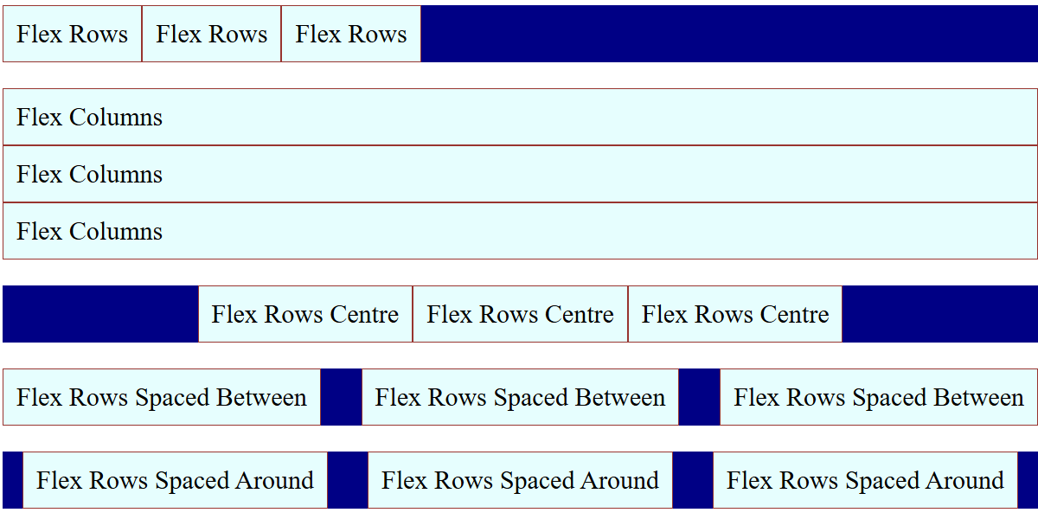
Using Flexbox - Introduction
Flexbox is a one-dimensional layout system for arranging items in rows or columns.
It helps with
alignment,
spacing, and
responsiveness.

Slide 3
Flex Container Properties
flex-direction: Sets layout direction — use row (horizontal) or column (vertical).
justify-content: Aligns items along the main axis — flex-start, center, or space-between.
align-items: Aligns items on the cross axis — stretch fills space, center aligns neatly.
.container {
display: flex;
flex-direction: row | column;
justify-content: flex-start | center | space-between;
align-items: stretch | center;
}
view

Slide 4
Flexbox Basics
.container {
display: flex;
gap: 10px;
}
.item {
flex: 1; /* each item takes equal width */
background: #4CAF50;
text-align: center;
padding: 20px;
}
💡 Flex container with equal-width items.
How it works:
display: flex → turns container into a flexible layout
flex: 1 → items grow equally to fill available space
gap → adds consistent spacing between items
Why it matters:
Simplifies responsive layouts without floats or grids
Items automatically adjust width as container resizes
Foundation for many modern UI designs

Slide 5
Flexbox Alignment
💡 Distribute items horizontally and centre vertically.
.container {
display: flex;
justify-content: space-between;
align-items: center;
}

Slide 6
Flex Item Properties
align-self: Overrides align-items for a single item — e.g., center, flex-start, stretch.
order: Controls item position — lower numbers appear first, default is 0.
.item {
flex: 1; /* grow */
align-self: center; /* overrides align-items */
order: 2; /* item position */
}
view

Slide 7

Example: Horizontal Navigation Bar
<style>
nav {
display: flex;
justify-content: space-around;
}
</style>
<nav>
<a>Home</a>
<a>About</a>
<a>Contact</a>
</nav>
view

Slide 8
Responsive Card Layout
flex-wrap: Allows items to wrap onto multiple lines instead of shrinking use wrap for responsiveness.
flex: 1 1 calc(33.33% - 20px)
1 → item can grow
1 → item can shrink
calc(33.33% - 20px) → base size (1/3 width minus gap)
.cards {
display: flex;
flex-wrap: wrap;
gap: 20px;
}
.card {
flex: 1 1 calc(33.33% - 20px);
min-width: 250px;
}
view

Slide 9
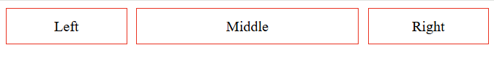
Setting proportional size
This example shows how to set double space for one element (flex:2)
Flex:1
10px
Flex:2
10px
Flex: 1
<body>
<div class="container">
<div class="item">Left</div>
<div class="item middle">Middle</div>
<div class="item">Right</div>
</div>
</body>
.container {
display: flex;
gap: 10px;
}
.item {
flex: 1;
}
.middle {
flex: 2;
}

Slide 10
Flex Wrap & Order
.container {
display: flex;
flex-wrap: wrap;
gap: 10px;
}
@media (max-width:600px) {
.item:nth-child(3) {
order: -1;
}
}
💡 Items wrap and reorder on small screens.

Slide 11
Flex Tips
Use `flex-wrap: wrap` for responsiveness
Combine `gap` with `flex` for consistent spacing
Test flex behavior at different screen widths

Slide 12
Lab – Flex
Experiment with different flex attributes

